Slide 1

ONLINE RESUME BUILDER USING JAVA

Slide 2
Jawaharlal Nehru University School Of Computer And Systems Sciences Submitted By: Aparna Ghosh (22/10/JC/019) Lipsa Mandal (22/10/JC/043) Shiya (22/10/JC/018) Submitted To: Prof. Sachin Balkrushna Jadhav

Slide 3
CONTENT
Problem Definition
Objectives
Software Requirements Specifications
How Does it Work?
Source Code
Output
Thankyou

Slide 4
Problem Definition A resume, is a formal document that provides a summary of a person's education, work experience, skills, achievements, and other relevant information. It is typically used to apply for employment opportunities and is an essential tool in the job search process. In this project we've created an Online Resume Builder using Java

Slide 5
Objectives 1. To teach the basics of Java programming language and how to utilize it to create a functional Resume builder.
2. To provide step-by-step instructions on how to develop a CV builder in Java, including the creation of a graphical user interface (GUI) and the implementation of data structures.
3. To implement the itextpdf package to get access to PdfWriter & Document class which in turn creates a pdf file & makes it possible to edit it. 4. To help learners gain practical experience in developing a real-world application in Java and apply the concepts learned to future programming projects.

Slide 6
Software Requirements Specifications 1. IntelliJ IDE 2. Swing Module to create GUI 3. itextpdf.jar dependency

Slide 7
How does it work?

Slide 8
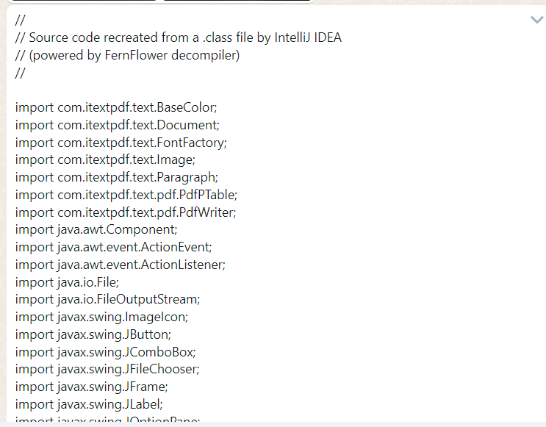
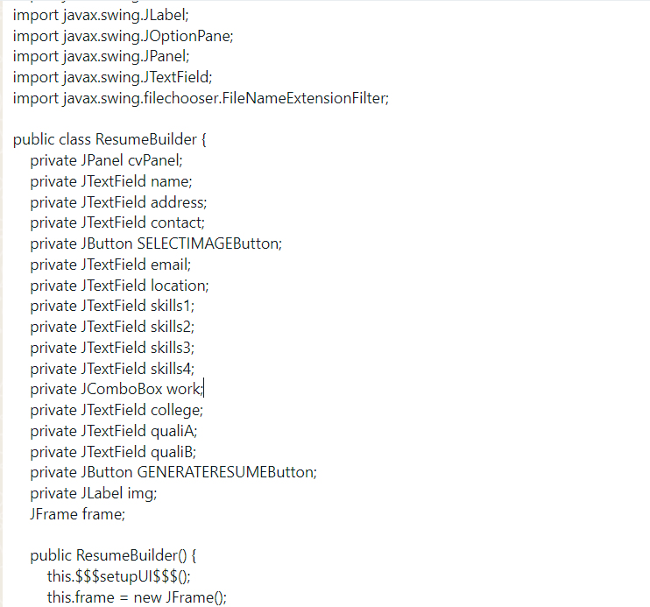
Source Code

Slide 9
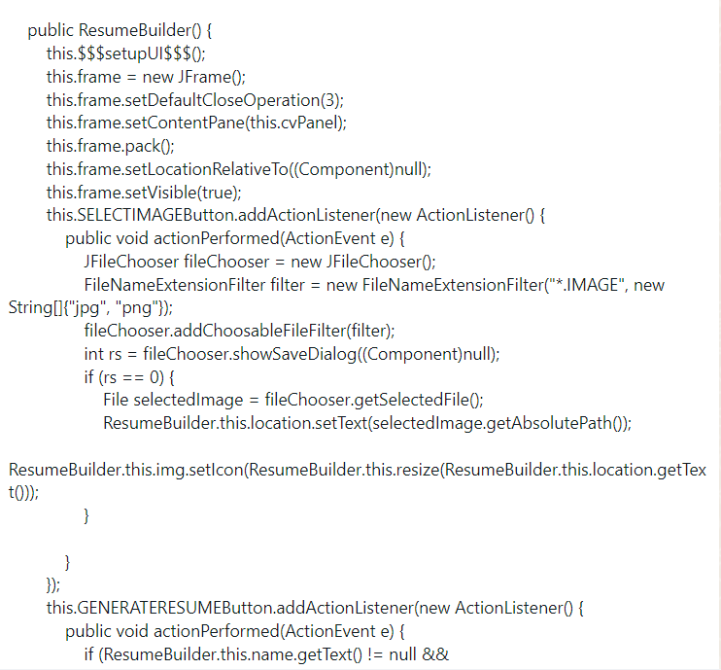
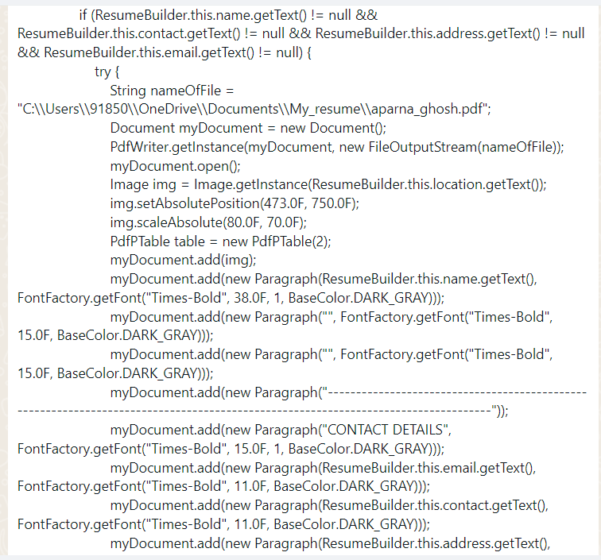

Slide 10
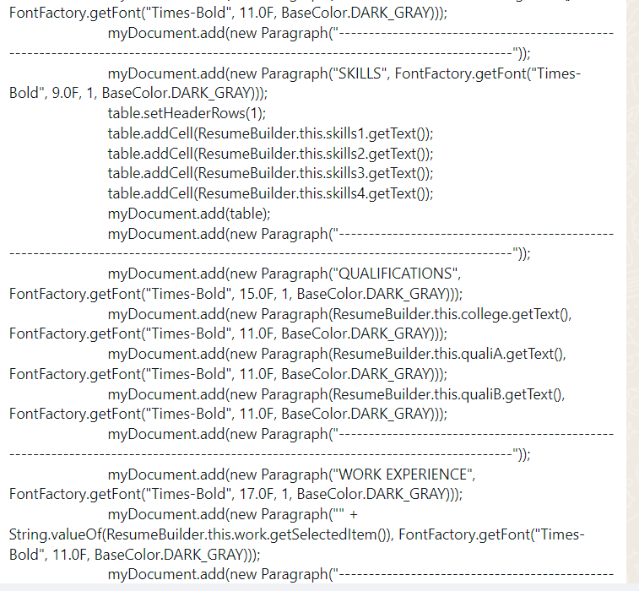
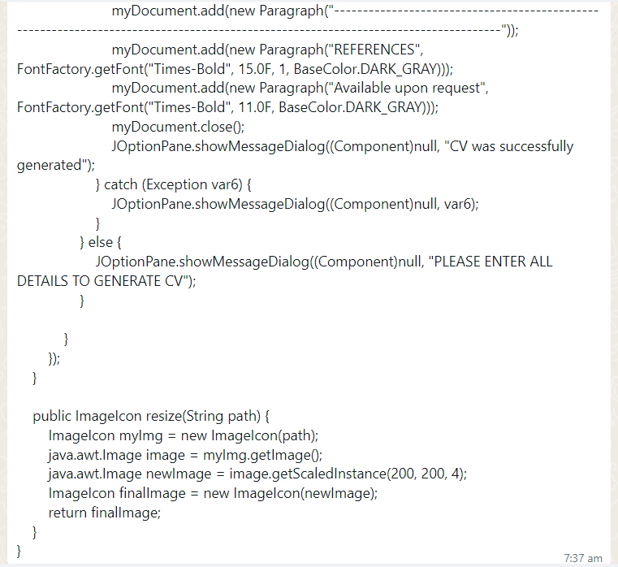

Slide 11
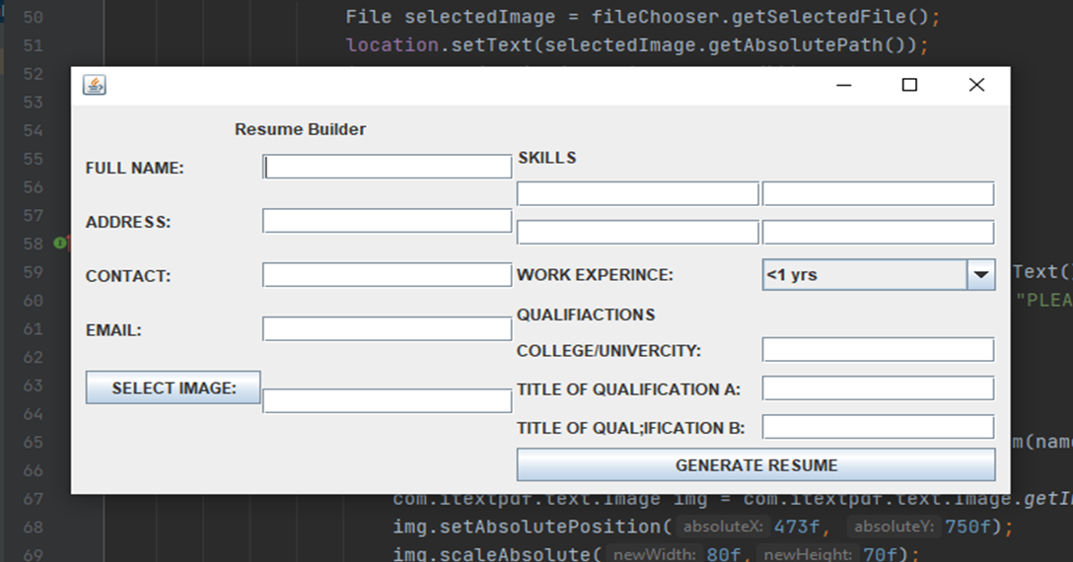
Output

Slide 12
THANK YOU

